Slide 1
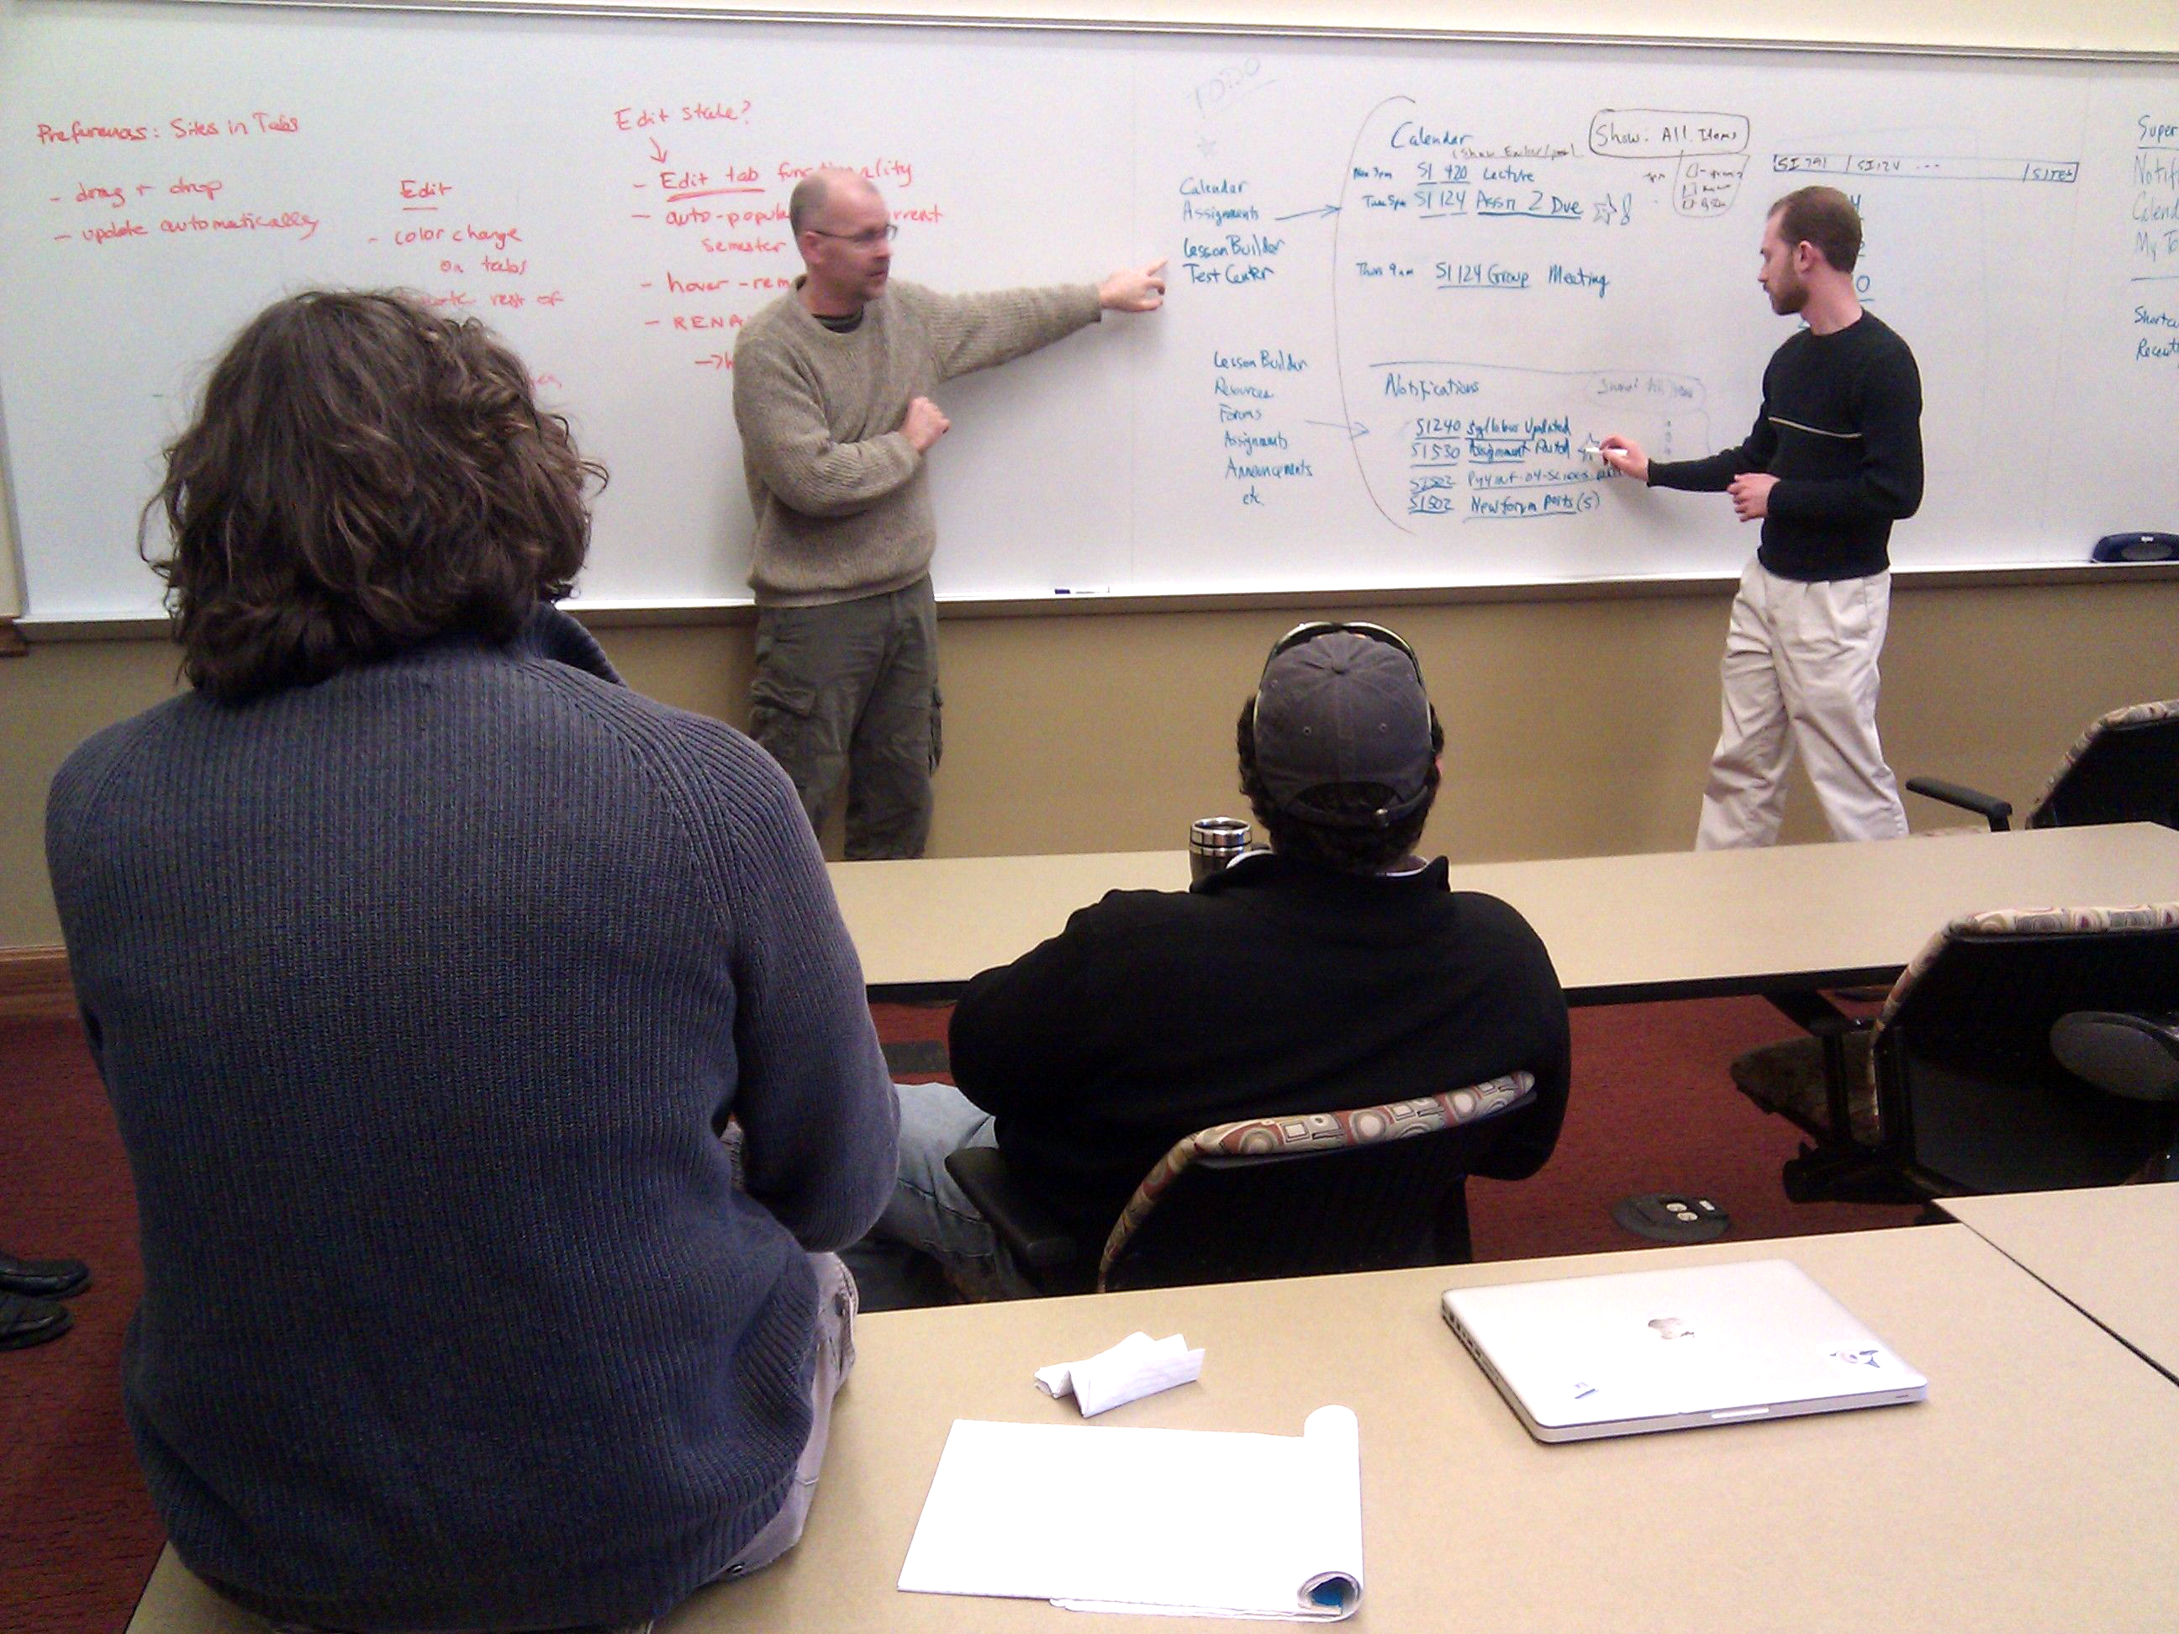
Redesigning the 2.9 Portal with the User in Mind

Slide 2
Redesigning the 2.9 Portal with the User in Mind
Guiding Questions
What are the current ‘pain points’ for CTools users?
What could we discover from regular CTools users who were studying to become user experience designers?

Slide 3
Redesigning the 2.9 Portal with the User in Mind
User Interviews
“Everything is buried so many layers deep. The navigation is hard work right now.”
“That first page is a waste, there's never any content on it.”
“There's no good search functionality.”
“All the course numbers start getting confusing after you get a lot of classes in there, especially since they never disappear from the nav bar.”
“If I want to see an old class or group it’s a pain to find it.”

Slide 4
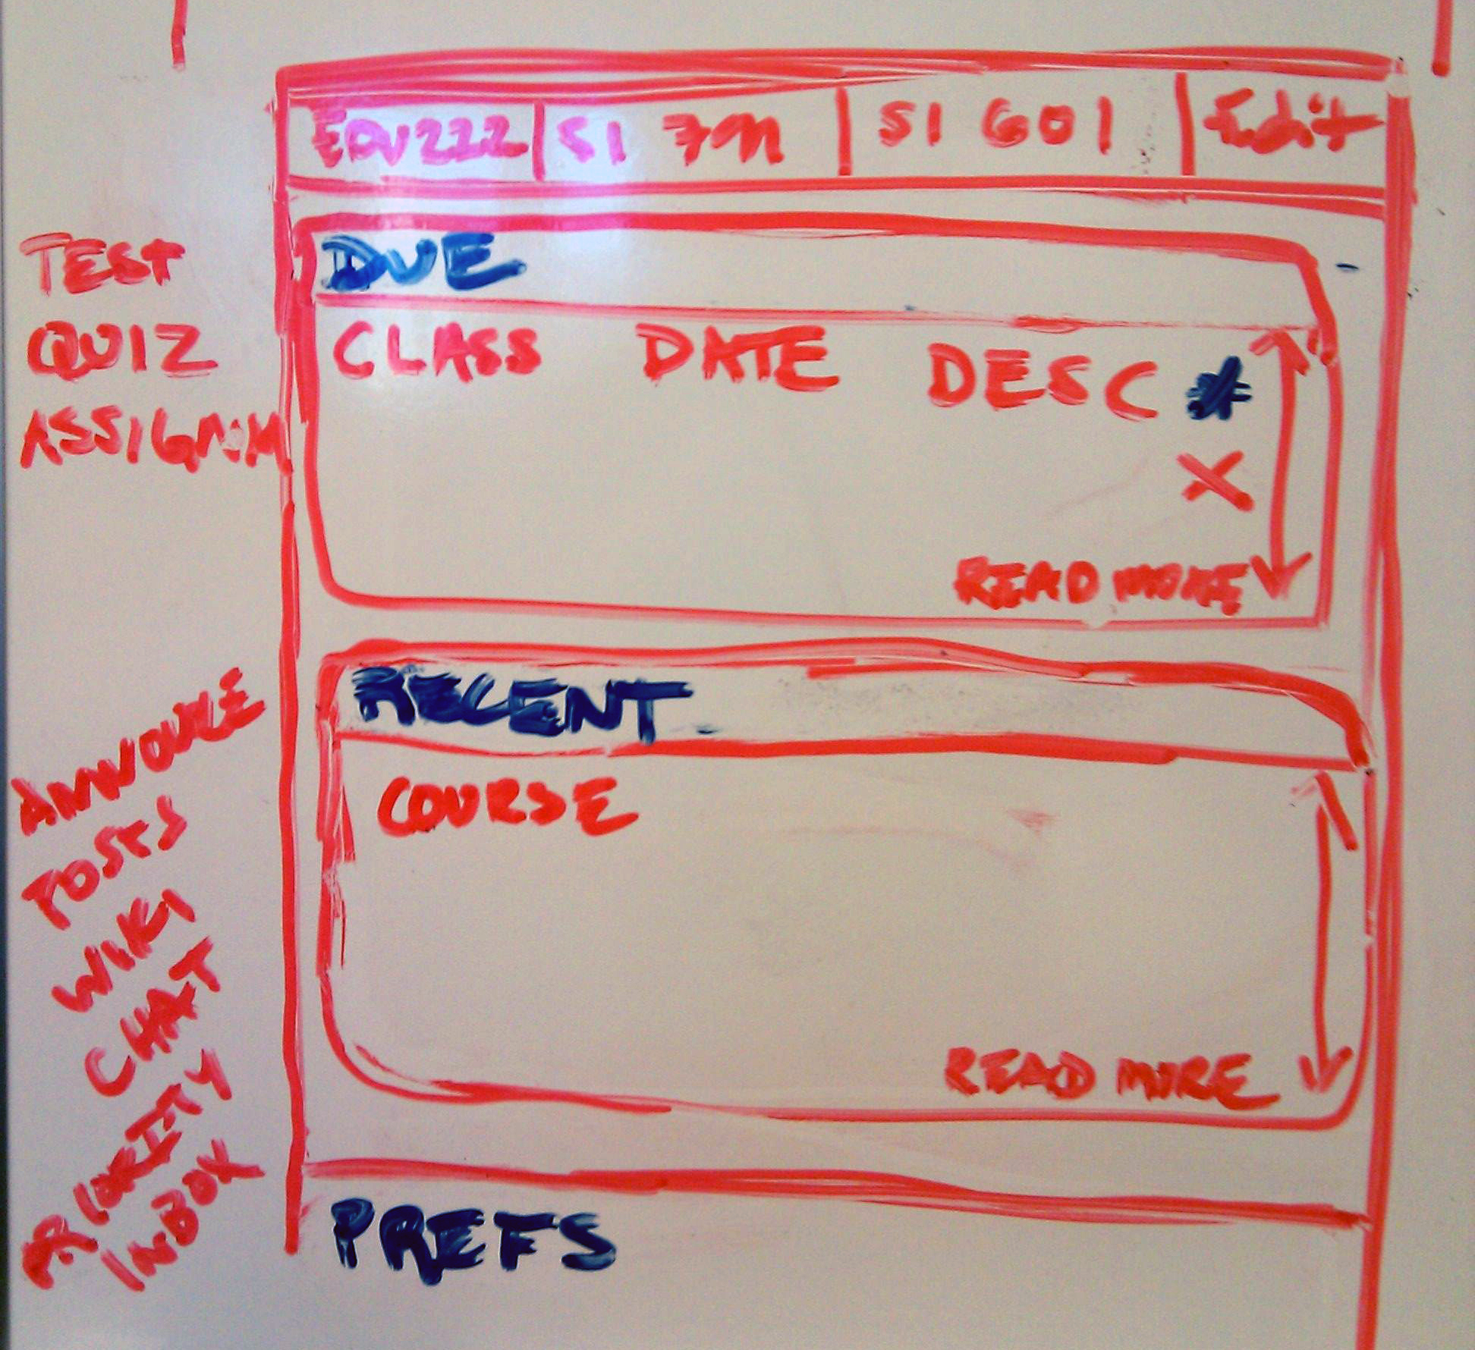
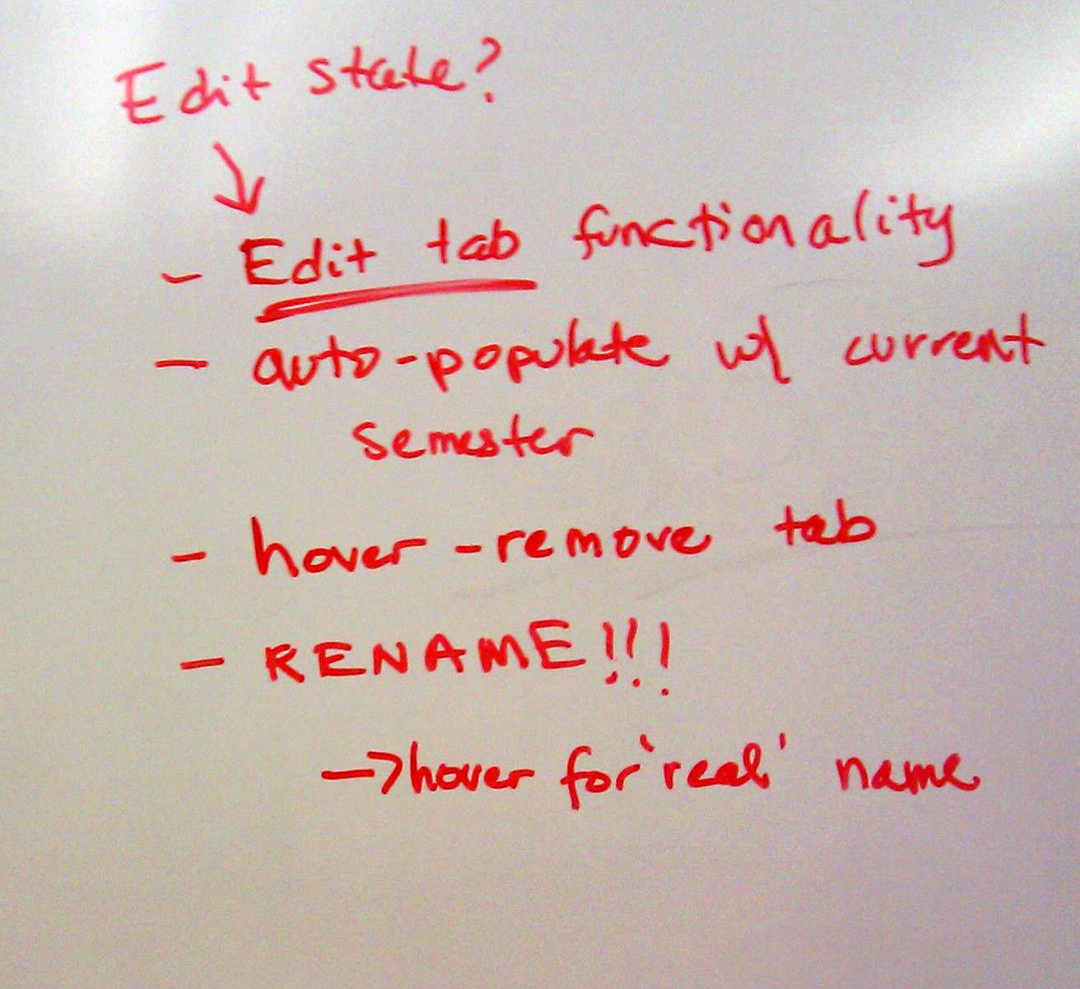
Redesigning the 2.9 Portal with the User in Mind
Brainstorming Solutions

Slide 5
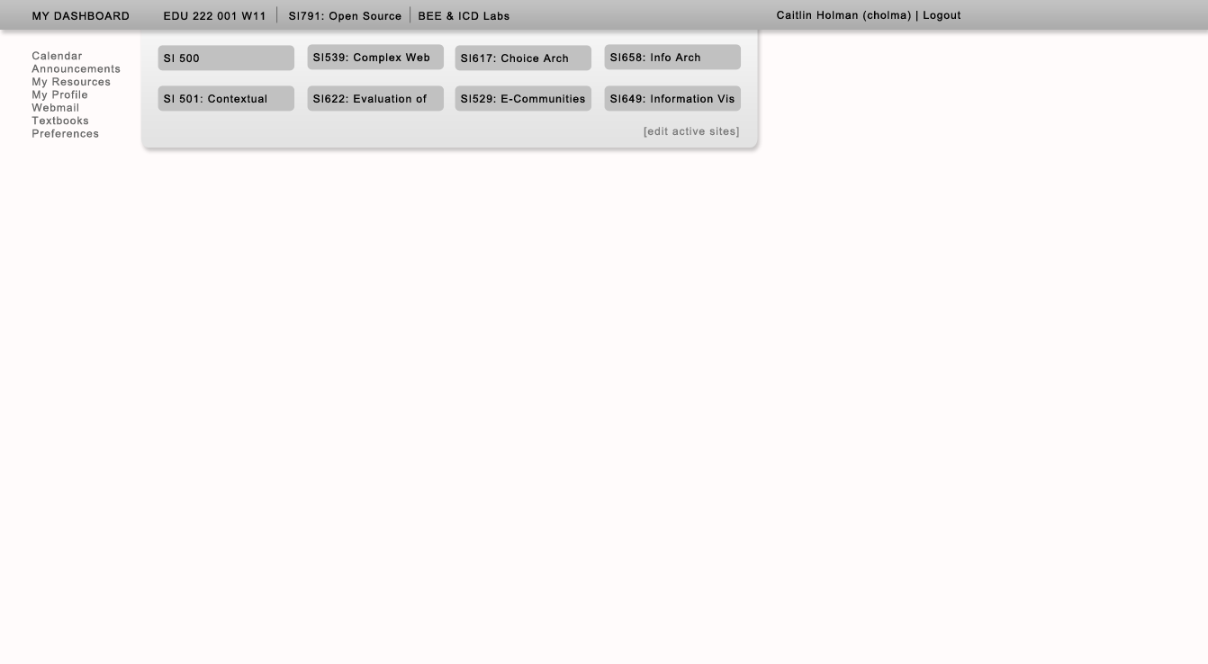
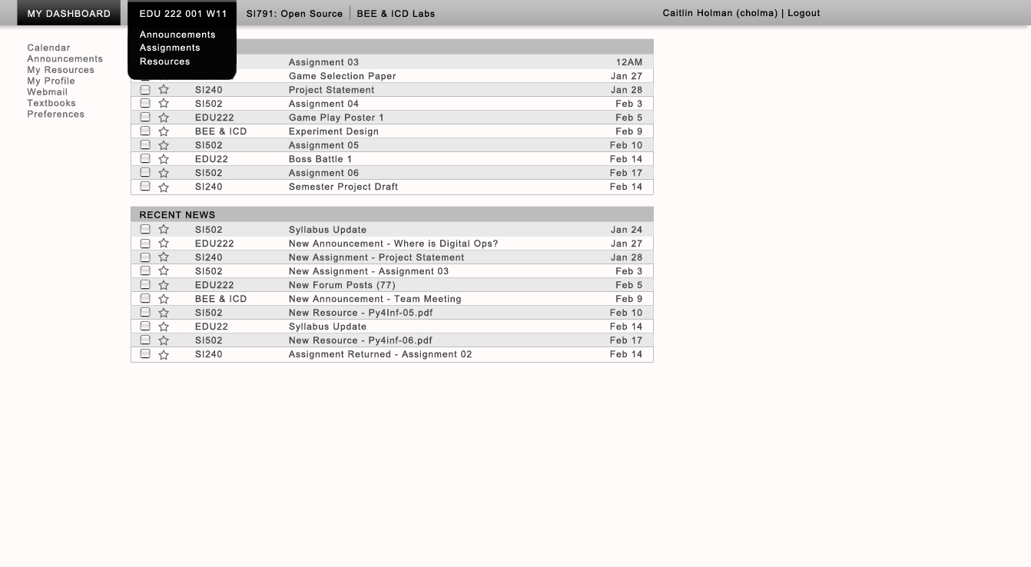
Redesigning the 2.9 Portal with the User in Mind
Sketches

Slide 6
Redesigning the 2.9 Portal with the User in Mind
Current Iteration

